Slide 1







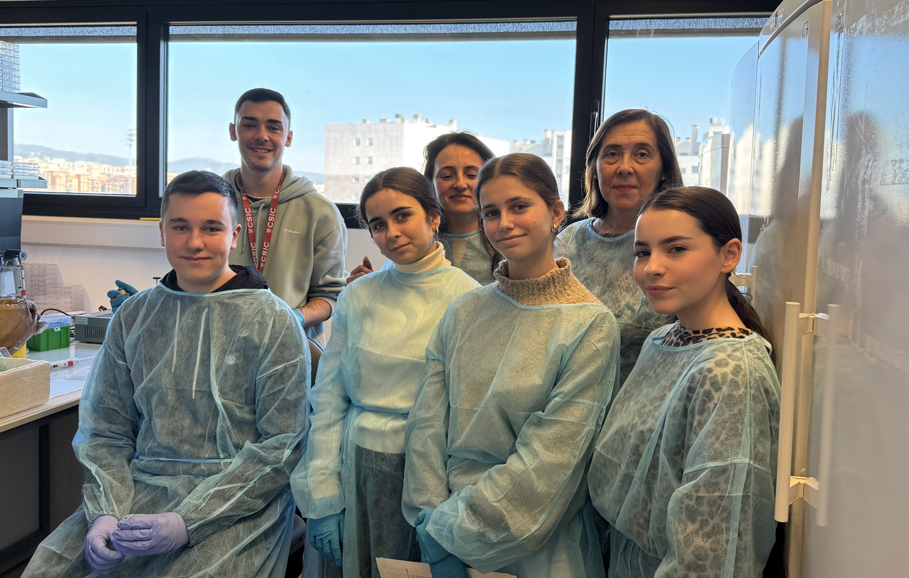
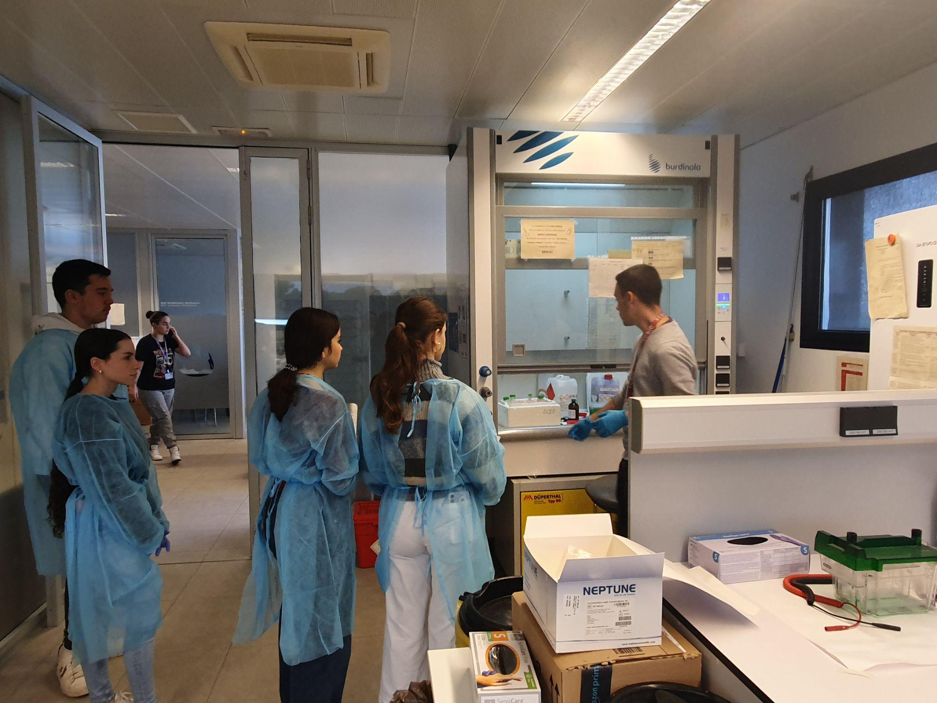
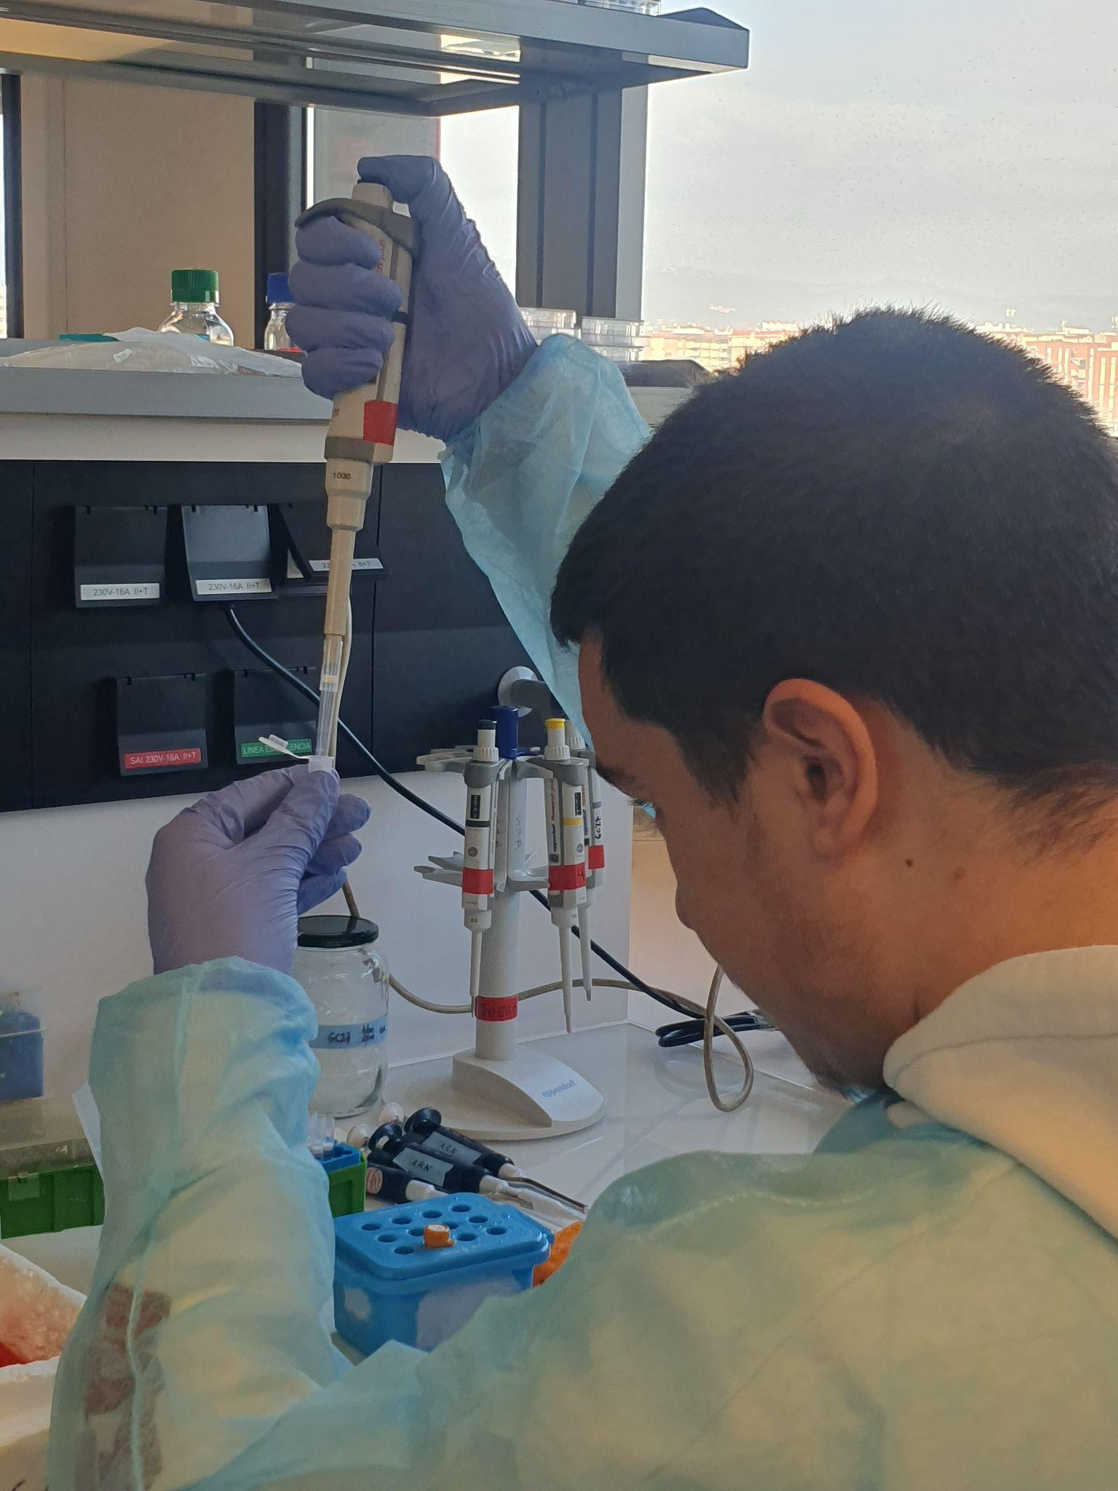
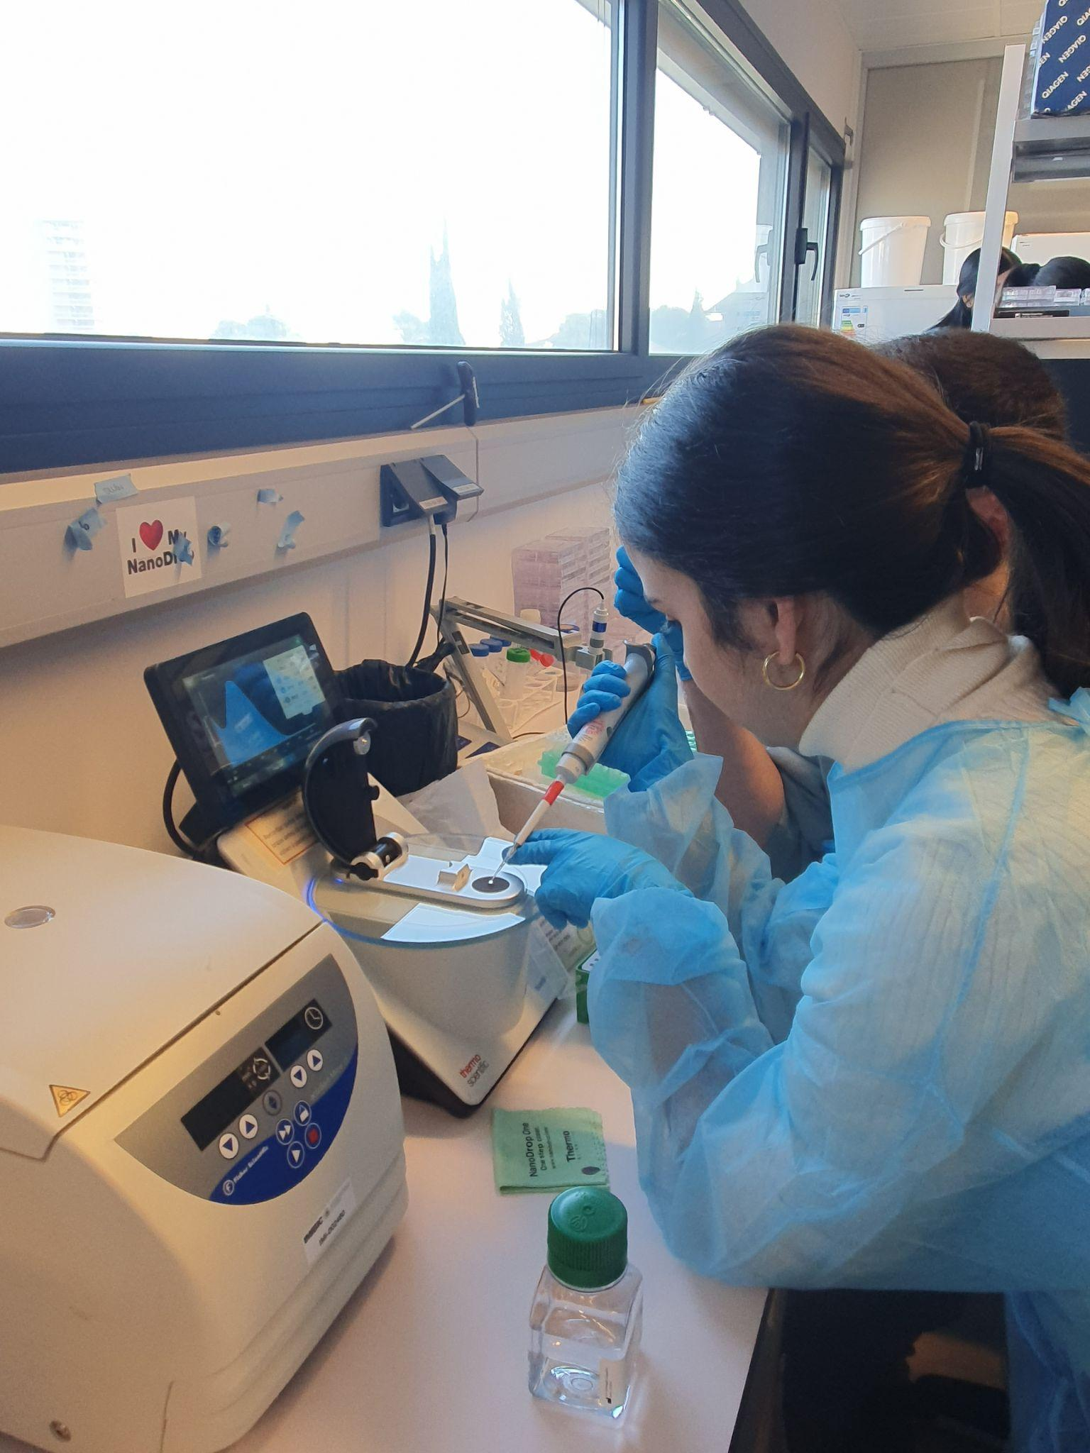
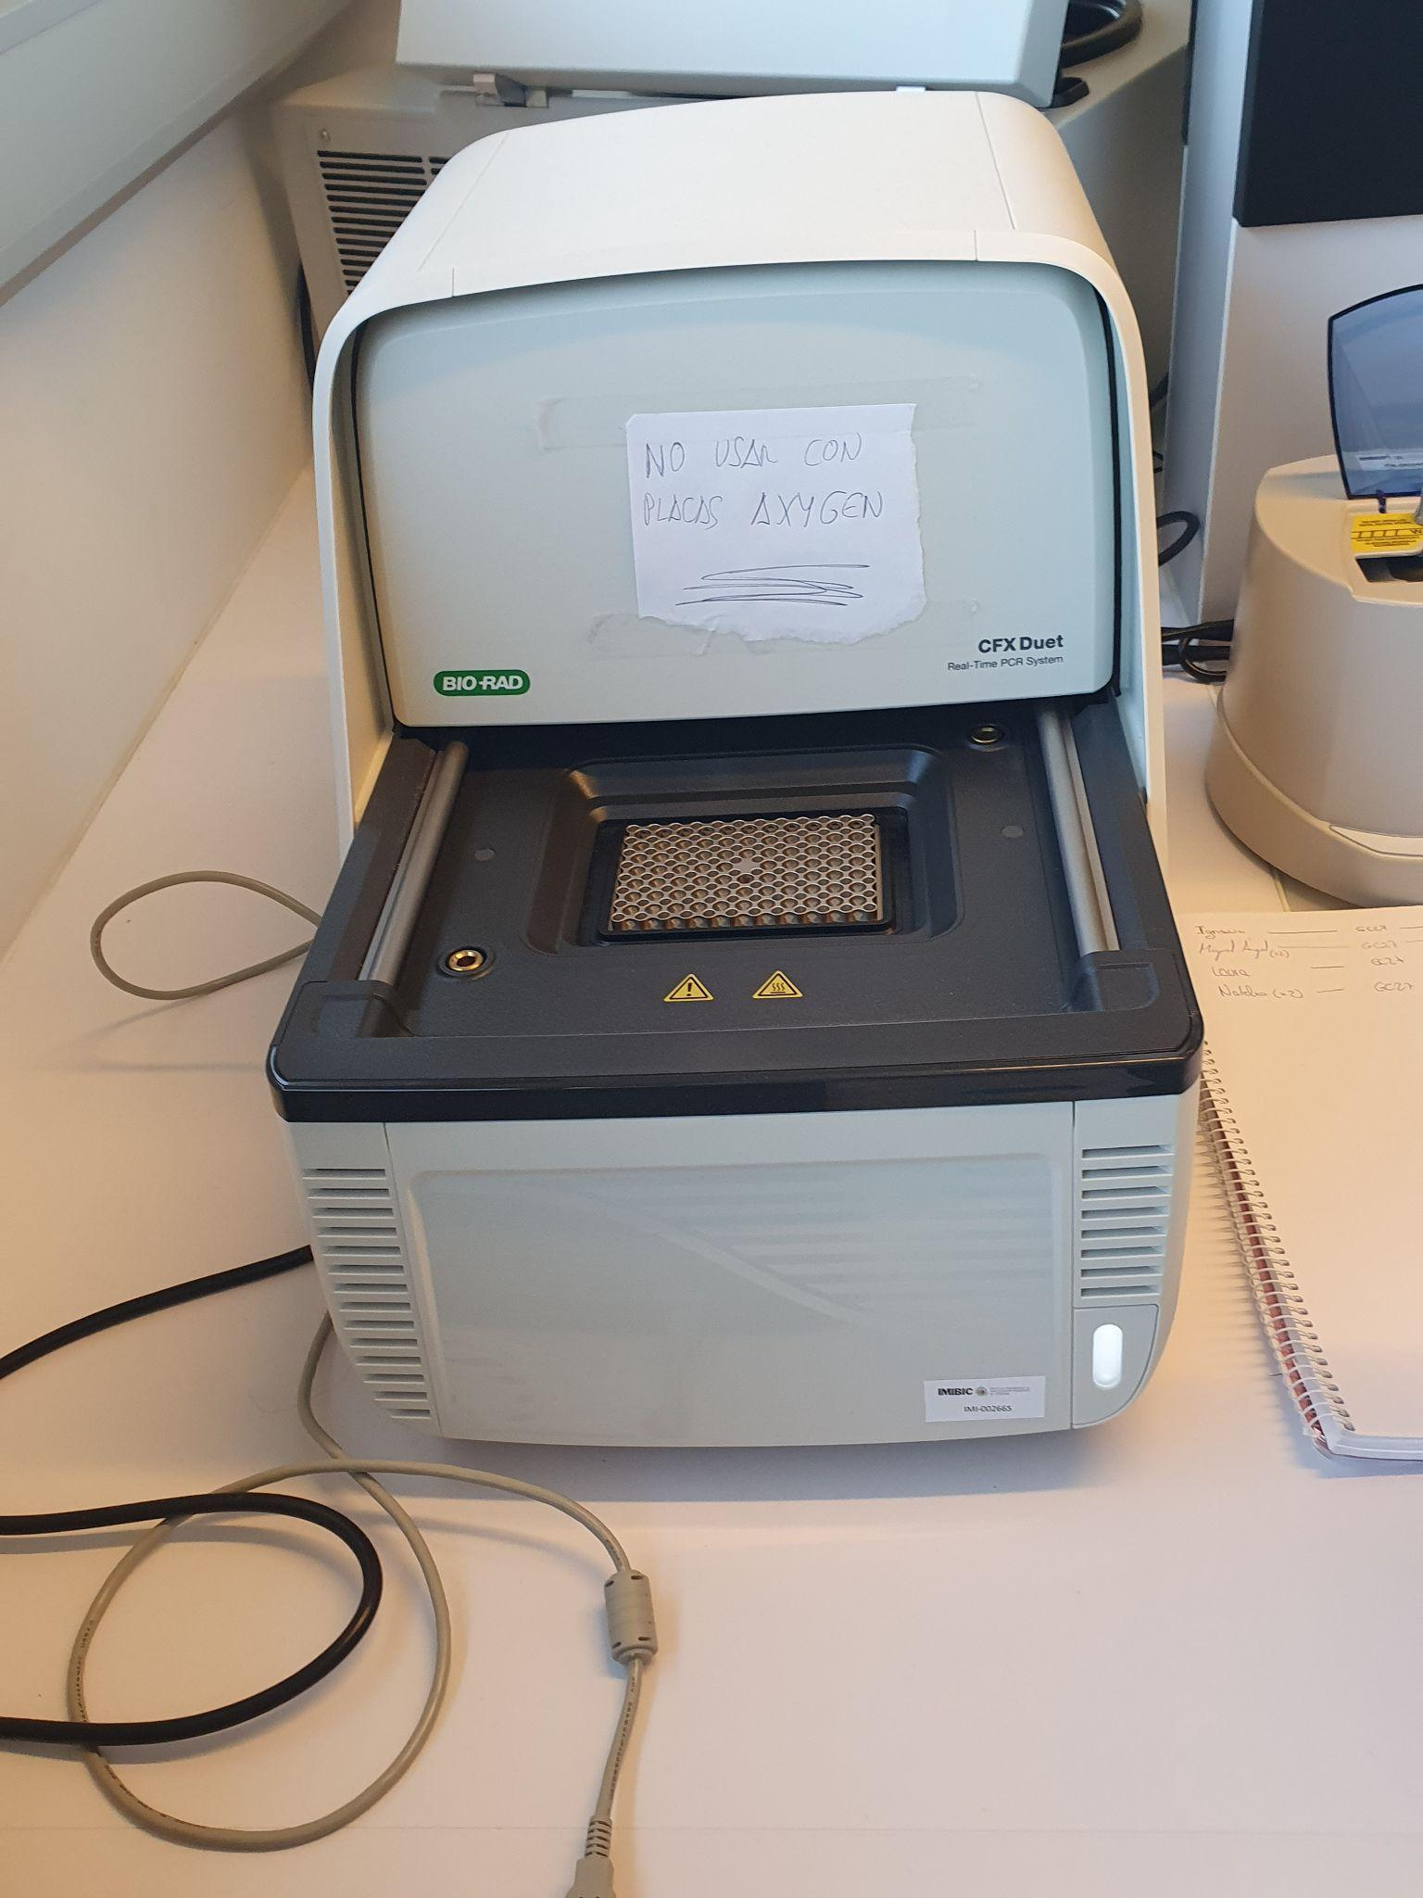
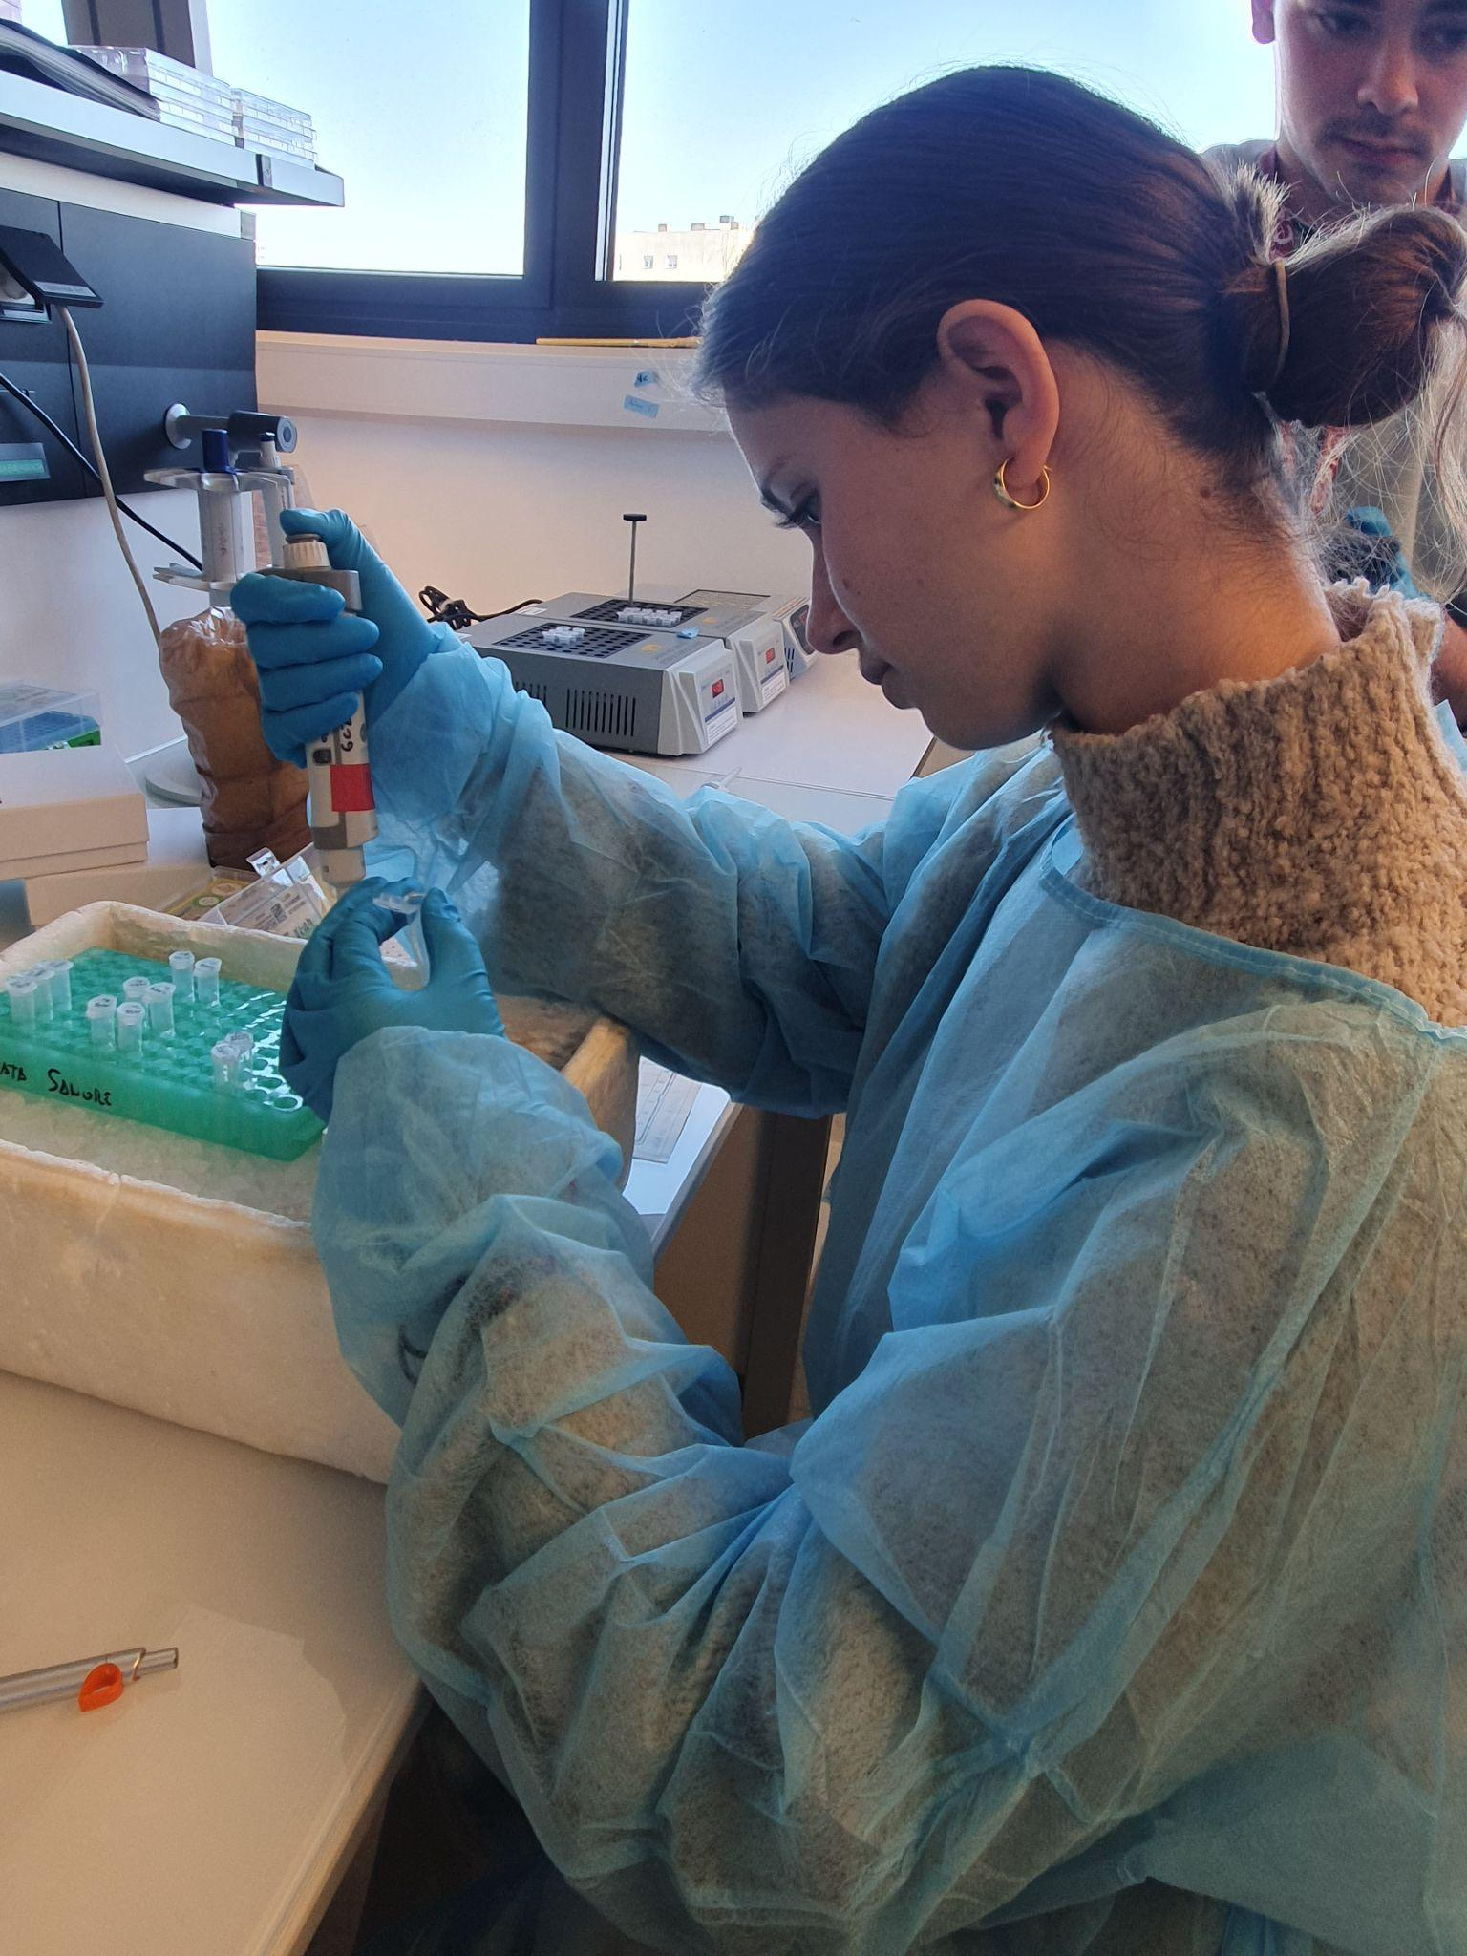
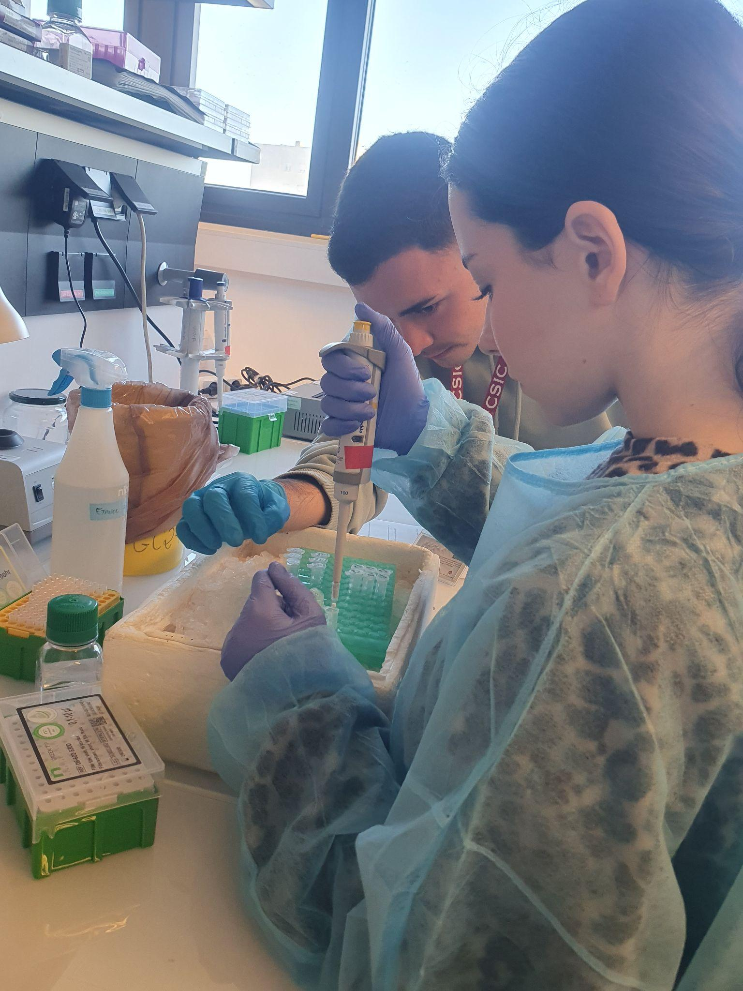
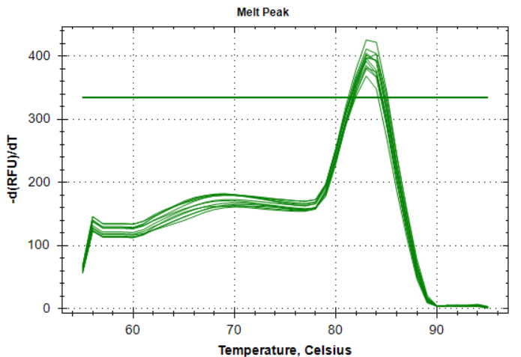
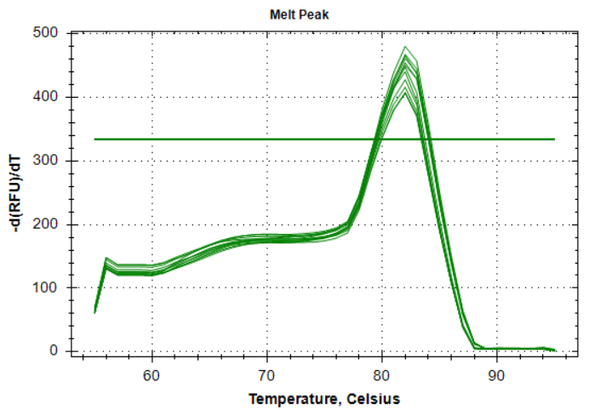
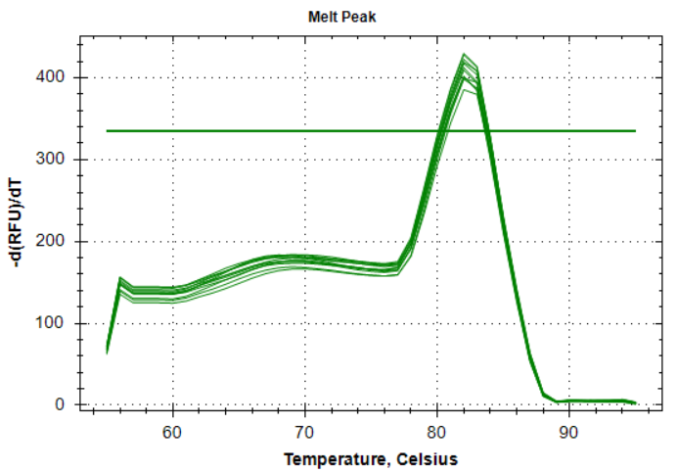
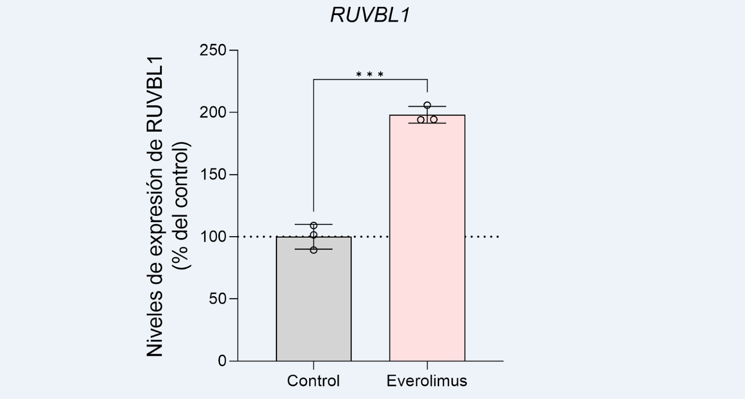
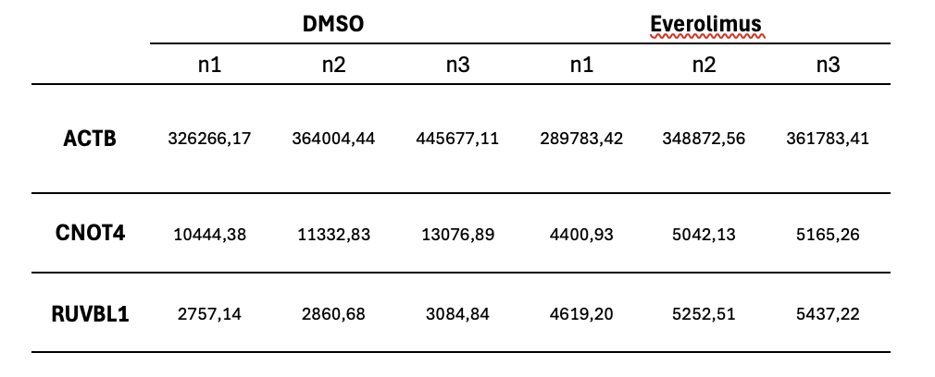
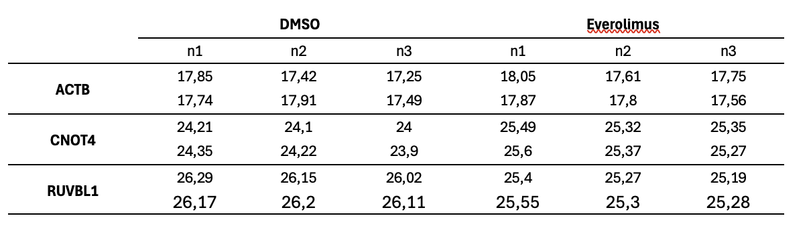
Altered expression of regulatory components of RNA metabolism in prostate cancer
STUDENTS: Martínez-Moriana, L.², Moreno-López, E ². Porras-Moya A.¹, Serrano-Hernández, A.¹
COORDINATING PROFESSOR: García-Larrea M.², León-Rodríguez, E.¹
RESEARCHER: Gil-Duque, I. ³
¹IES Fidiana
²Centro Zalima
³IMIBIC
INTRODUCTION
MATERIALS AND METHODS
Prostate cancer is the most common tumour pathology in the male population in developed countries. Currently, the main therapy consists of blocking androgen signalling. However, a large number of patients become resistant to it, progressing to the most aggressive type of the disease, castration-resistant prostate cancer (CRPC).
Despite the recent development of androgen receptor (AR) signalling inhibitors, CRPC remains lethal, making it crucial to develop new global and effective diagnostic, prognostic and/or therapeutic targets useful for the management of prostate cancer.
In this regard, it has recently been described that the deregulation of RNA metabolism control mechanisms plays a crucial role in several tumour types.
Thus, the possible deregulation of some of these control mechanisms (e.g. nonsense-mediated decay) in prostate cancer may be associated with the onset, progression and aggressiveness of these tumours.
ARN EXTRACTION HOOD
DNAsa
QUANTIFICACION
OBJECTIVES
To analyse the expression of markers of aggressiveness in prostate cancer and regulatory components of RNA metabolism in response to treatment of brain tumour cells with pharmacological inhibitors.
qPCR MACHINE
Thermocycler
qPCR LOAD
RETROTRANSCRIPTION
RESULTS
1) QUALITY OF ARN
3) MELTING GRAPHICS
Table 1. Determination of RNA concentration and quality
A | B | C
SAMPLE | ng/µl | A260/A280 | A260/A230 | A260 | A280
1 | 169,5 | 2,12 | 2,07 | 4,24 | 2,00
2 | 425,2 | 2,15 | 1,68 | 10,63 | 4,96
3 | 291,8 | 2,13 | 2,06 | 7,29 | 3,42
4 | 393,9 | 2,14 | 1,67 | 9,85 | 4,59
5 | 1136,9 | 2,13 | 2,13 | 28,42 | 13,37
6 | 771,2 | 2,12 | 2,11 | 19,28 | 9,10
RNA concentration and purity ratios of extracted samples
Graph 1: Melting curves in genes studied. Temperature in degrees Celsius is represented with respect to relative fluorescence unit. A) ACTB gene. B) CNOT4 gene. C) RUVBL1 gene.
2) qPCR QUANTIFICATION
4) GENE EXPRESSION
Table 2. Cycles obtained in qPCR
CNOT4 expression levels (% of control)
RUVBL! expression levels (% of control)
Table 3. Gene expression levels as a percentage of temperature.
Figure 2: CNOT4 gene expression levels under DMSO (control) and Everolimus treatment. The measurement error (error bar) of the three measurements is indicated.
Figure 3: RUVBL1 gene expression levels under DMSO (control) and Everolimus treatment. The measurement error (error bar) of the three measurements is indicated.
Considering both graphs, it can be concluded that Everolimus treatment differentially modulates gene expression, suppressing CNOT4 gene expression and significantly increasing RUVBL1 expression compared to the control (DMSO). This suggests that the drug may be regulating specific cellular processes related to cell proliferation.
CONCLUSIONS
ACKNOWLEDGEMENTS
Everolimus treatment decreases the expression of CNOT4 in prostate cancer lines, while, on the other hand, this treatment increases the expression of the RUVBL1 gene.
In conclusion, Everolimus treatment in prostate cancer could modulate NMD expression and function, although it would be necessary to explore the different mechanisms by which the effect of NMD and its relationship with prostate cancer could be altered.
To the group GC27 ‘OncObesity and Metabolism’ of IMIBIC
To the researcher Ignacio Gil Duque
IES FIDIANA and Centro Zalima.
To the teachers Mabel García Larrea and Elena León Rodríguez
To the Educational Innovation and Curriculum Development Project FIDICIENCIA 3.0 (Andalusian Regional Government).

